Slide 1
World Lit. Prospectus and Video Project

Slide 2
But first an important message…
From our syllabus

Slide 3
And now a second important message…
From our syllabus

Slide 4
Video Project Tips!
(Prospectus to submission of video)

Slide 5
What is a Prospectus? A pitch of your project

Slide 6
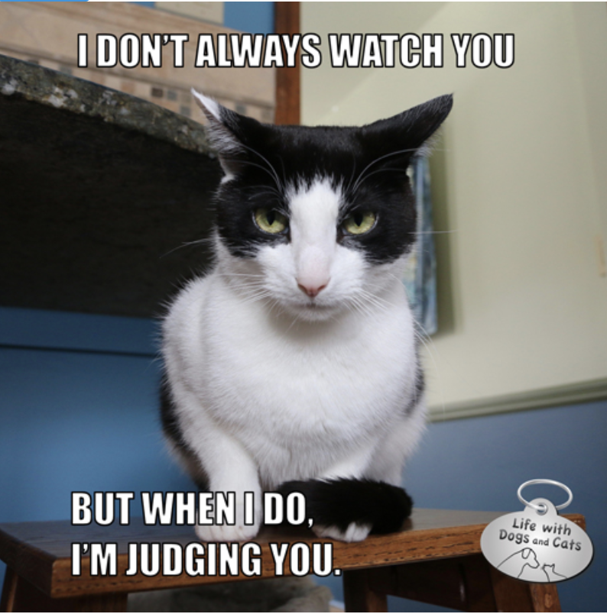
What is a Prospectus? A pitch of your project

Slide 7
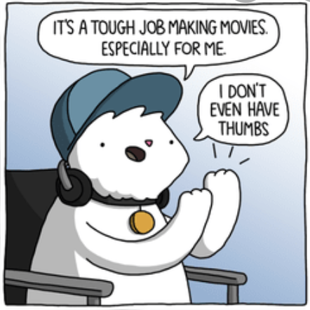
What is a “prospectus” anyway?
A paragraph (100 words)
What do I need to include?
Title
Focus (2 points)
Choice of Materials (2 points)
Context/Observation (2 points)
Research Question (2 points)
Importance (2 points)

Slide 8
How do I pick a title? * [for the next few slides think about your own possible video]
Titles are what get people to notice your work.
They should be eye-catching, appropriate and informative.
Titles that are too generic don’t give people enough information.
Titles that contain concrete details and something intriguing are effective.

Slide 9
How do I pick a focus or theme? *
Take a moment and think about which issues you have found most interesting this spring.
You may have several ideas, but you will want to concentrate on one general area.

Slide 10
Just to start the thinking process:
Ethical leadership The role of violence The role of women Representations of sexuality The role of magic and the supernatural
The role of dreams The role of animals
Friendship and companionship
Immigration and outsiders
The power of storytelling
Justice and punishment
The place of human beings in the world
The idea of an afterlife

Slide 11
And a few more…
The idea of an afterlife
The role of the imagination
The value of personal responsibility and duty
Problems with language and words
The role of hospitality and food
The role of faith and religion
The value of education
Treason and betrayal
The relationship between parents and children
The role of art and literature
Love and romance
The consequences of wealth and privilege, ETC.

Slide 12
What materials may I choose?
Required: Any two texts from the syllabus, from Gilgamesh to Pushkin (excluding the text you chose for the short essay).
Optional: Any additional materials, either from the WordPress site or from your own knowledge, that enhance your project. You may include the text from your essay as an additional material but not a primary text.

Slide 13
What do you mean by context and observations?
Think about what perspective you are taking on the works, in what context you are placing them, especially whether you are viewing them in their original settings or exploring what they mean for you in 2025.
Be sure to mention a few concrete details from each text which you plan to consider.

Slide 14
What is a good research question?*
It should be controversial – which means?
Intelligent people might have different opinions about the topic. You should do more than state the obvious, summarize the text, or simply repeat historical facts. A “controversial” project has a number of potentially valid perspectives, which are debatable. It is up to you to make the case, based on evidence and logic, for your point of view.

Slide 15
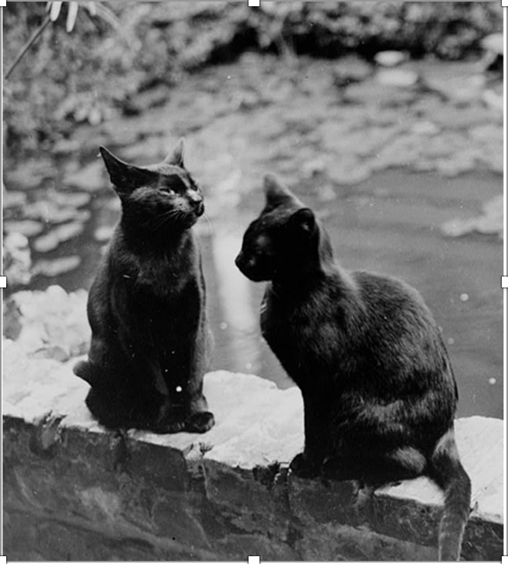
If you can answer your question with yes/no it is probably not controversial.

Slide 16
How do I give my project importance?
Answer your own controversial research question.
Offer a rationale for your answer.
Tell your viewer why your work matters.
SO WHAT? *

Slide 17
What do I do next? Submit the prospectus to my TA for scoring and comment
My TA will do one of 2 things:
1. Approve it and make suggestions.
2. Recommend changes before approving it.

Slide 18
Sorry – No TikTok please –
UT does not permit its use!

Slide 19
For the video, what do you expect?
This project is typical of short videos people make as part of many applications and in many professions.
6-8 minutes of my voice with or without additional A/V materials
I may appear on screen as little/much as I like.
I will share a link to the file on Canvas.

Slide 20
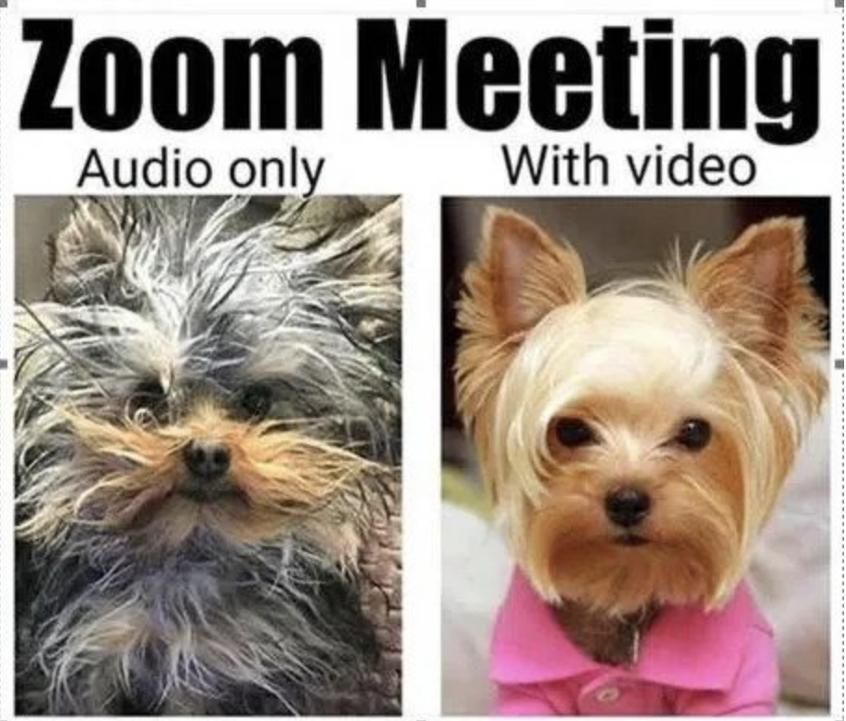
How do I plan for the video?
I will make a script (not turned in).
I will practice the script.
I will record myself on Zoom using screen sharing (recommended or equivalent).
I may edit the video, but editing is not required.

Slide 21
So what about that research question, again? Examples of not-great options: (description or compare/contrast only)
• How are the images of women in Medea and
Faust different?
• Are Medea and Gretchen evil characters?
• Were women treated unfairly in ancient
Greece and 19th-century Germany?

Slide 22
No, really, I need some models, please?
How are the images of women in Medea and
Faust different?
Given that both Medea and Gretchen find themselves abandoned and destroy their children, how and why do their different motivations matter?

Slide 23
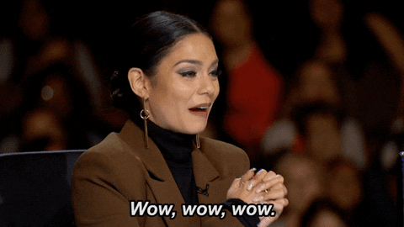
No, really, I need some models, please?
Are Medea and Gretchen evil characters?
How do the words and actions of Medea and Gretchen both reveal and critique the ethical norms of their communities for modern audiences?

Slide 24
No, really, I need some models, please?
Were women treated unfairly in ancient Greece and 19th-century Germany?
What is the impact on a modern audience of experiencing the gender double standard imposed in ancient Greece and 19th-century Germany on Medea and Gretchen?

Slide 25
Anything else?
PLEASE JUST ASK!
YOUR TA AND I ARE SO HAPPY TO TALK IN PERSON, VIA ZOOM AND ON EMAIL!

Slide 26
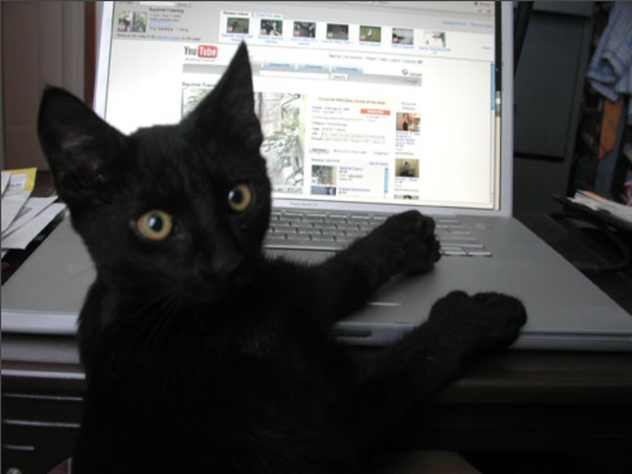
Anything else?
PLEASE JUST ASK!
YOUR TA AND I ARE SO HAPPY TO TALK VIA ZOOM AND EMAIL!

